Slide 1
Emotional Intelligence (EQ)
What do parents really need to know?
Stasia Rivera MA, SEP
Specializing in Family Systems, Shock & Developmental Trauma
© 2019 Let’s Talk About Recovery. All Rights Reserved
Notes:
Full Circle
Two Emotions – Anger & Anger

Slide 2
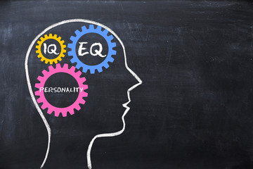
IQ vs EQ
Psychologist Daniel Goleman estimates that, at best, IQ makes up only 20 percent of the factors that determine life success.
  Verbal comprehension
  Memory
  Processing Speed
Emotional Intelligence

Slide 3

Other Factors of Success
  EQ
  Wealth & Family Education Levels
  Individual Temperament
  Pure luck
Emotional Intelligence

Slide 4
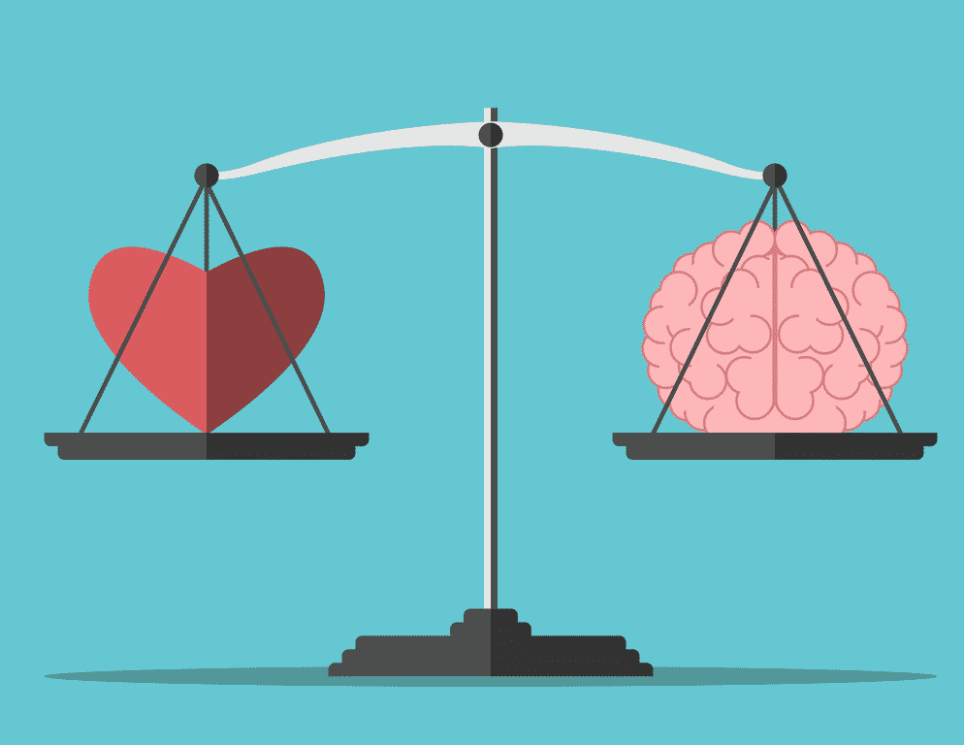
EQ Application
To really go the distance, those IQ traits need to be rounded out with:
  Social-emotional skills
  Motivation
  Perseverance
  Impulse Control
  Coping Mechanisms
  The ability to delay
  gratification
Emotional Intelligence

Slide 5
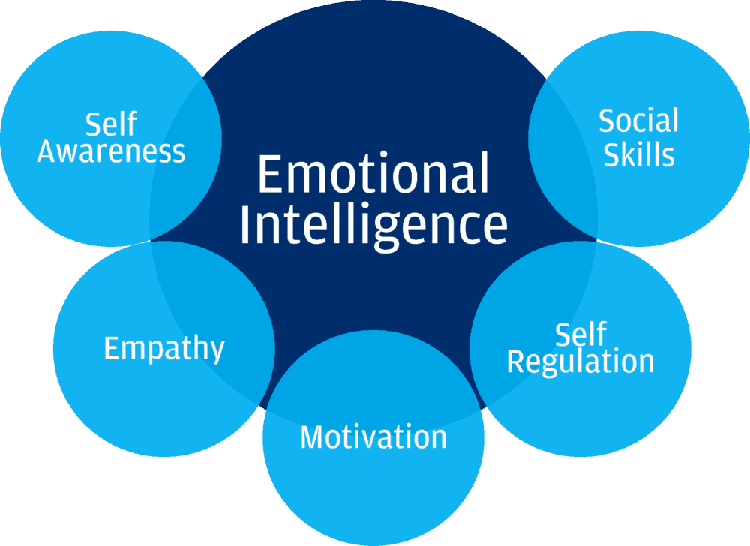
5 EQ Traits
Emotional Intelligence

Slide 6

Self Awareness
Defined: a conscious knowledge of one's own character, feelings, motives, and desires
Create & offer a space for individuals to observe
Offer reflection of what you see
Model honesty and imperfection of your own positive and negative experiences
Disagree, but don’t stop listening.
Emotional Intelligence
Notes:
Observation
What did you notice? In your mind? Your emotions? Your body?
What happened at points of transition?

Slide 7

Self Awareness Language
Lines of Connection
It seems like this is what happened, did you think that?
Please take the time you need to figure it out and I will be ready to listen when you’re ready to talk.
What do you think happened to you when you heard that?
Emotional Intelligence

Slide 8

Self Regulation
Defined: the ability to respond to the ongoing demands of experience in a manner that is sufficiently flexible.
Supporting regular check-ins & 5 senses awareness
Insure basic care needs: sleep, nutrition & emotional hygiene
Reflect positive and negative shifts that you see
Limit technology as a tool of “regulation”
Emotional Intelligence
Notes:
Social Skills
Communicating needs and hearing needs of others

Slide 9
Self Regulation Language
Lines of Connection
I notice that you seem really happy when you are doing that activity.
It seems like you kind of don’t feel good when you are around that person.
My gut is feeling like that is not the best idea? What is yours saying?
Emotional Intelligence

Slide 10

Motivation
Defined: The reason or reasons one has for acting or behaving in a particular way.
Address trauma history (shock and developmental)
Identify +/- belief systems and demonstrate empathy
Don’t assume, be super curious!
Internal vs external discipline and motivation
Praise should build behavior
Emotional Intelligence

Slide 11
Motivation Language
Lines of Connection
I think it is totally a normal response to be nervous, I would be to.
If anything were possible and you couldn’t fail, what would you truly want?
What support do you need from me, what steps do you plan to take?
Emotional Intelligence

Slide 12

Empathy
The ability to understand and share the feelings and perspectives of another individual.
For self and others
Make kindness a priority
Self talk
Share your own feelings with your child
Make it easy for them to talk to you
Emotional Intelligence
Emotional Intelligence

Slide 13
Empathy Language
Lines of Connection
Please remember that your human and you’re going to do human things.
Have you considered how that impacted your friend?
You can’t be stupid, if you’re learning, try to remember that ok?
Emotional Intelligence
Emotional Intelligence

Slide 14

Social Skills
The skills we use to communicate and interact with each other, verbally & non-verbally
Environmental awareness
Understanding social norms
Communication & Listening
What to do when a relationship feels good or bad
When and how to apologize
Model forgiveness & responsibility
Emotional Intelligence

Slide 15
Social Skills Language
Lines of Connection
What do you think the coach expects from you at practice? Why?
When you go into the classroom what do you think you should do?
Have you considered communicating what you need to your teacher?
Emotional Intelligence

Slide 16
Identify & Discuss Emotions
Anger
Love
Shame
Guilt
Grief
Fear
Pain
Joy
Passion
Find and learn about emotions and create an awareness for all members of the family!
Emotional Intelligence

Slide 17
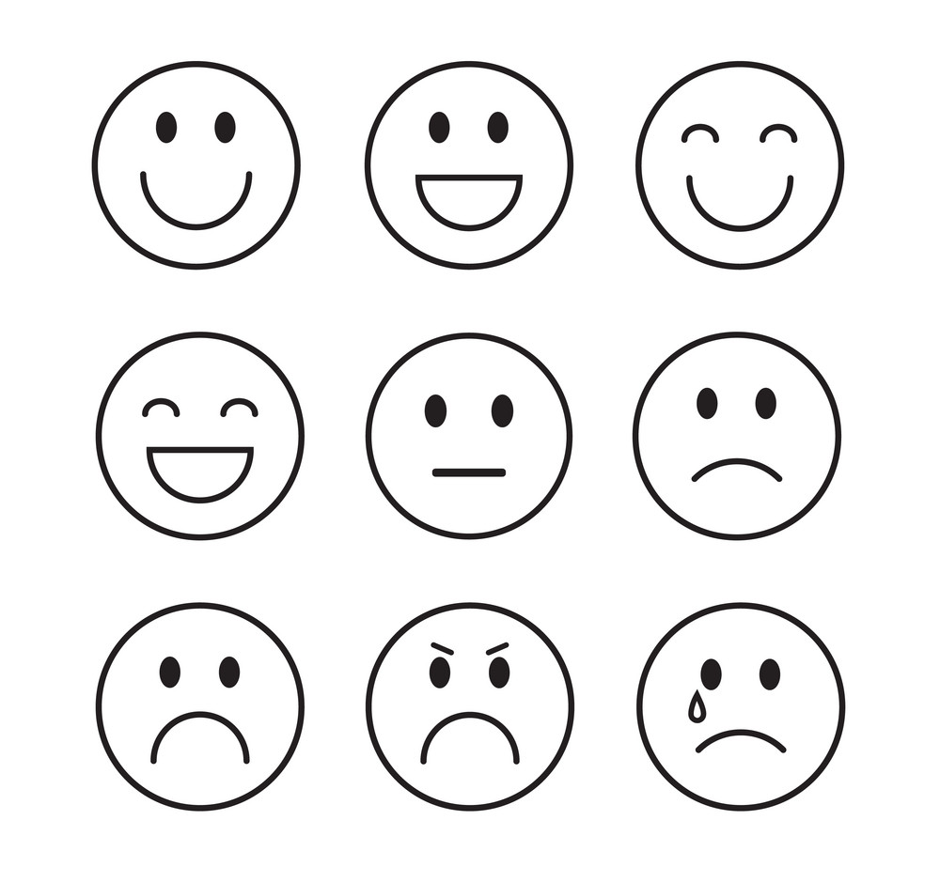
Emotional Granularity
What is it & WHY EQ Matters!
Research has shown that individuals that can express how they are doing overall when facing a real or perceived life stressor:
  Suffer from far less mental
  and emotional stress &
  experience less physiological
  distress overall
Emotional Intelligence

Slide 18
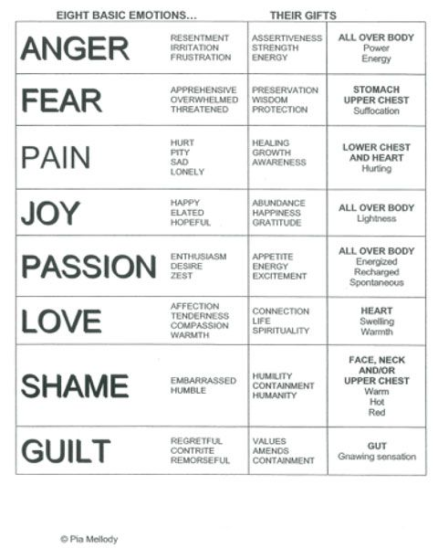
Pia Mellody – 8 Core Emotions
A wonderful guide to expanding your understanding and language around EQ
Helps you identify where you might be feeling it (bottom-up ☺)
Simplifies the countless emotions you may be experiencing to a language of 8 emotions
It reminds you that there are GIFTS of emotions too!
Emotional Intelligence

Slide 19
Practice the Process of EQ
Stop and reflect
Ask, yourself am I minimizing or maximizing?
Feel the emotion fully (top-down & bottom-up)
Evaluate and expand options of understanding
Tell someone (spiritually or in person)
You can and may need to take action
Every conflict or stressor is an opportunity to try again. This is a forever practice ☺
Emotional Intelligence
Notes:
Based on our belief systems, the chemicals that are released, etc.

Slide 20

x4 Top Tips for creating EQ
Application
Don’t hide your emotions and don’t try to change theirs!
Cultivate Bottom-Up Awareness
Learn their EQ language
Use ”I” Statements & ask ?’s
Emotional Intelligence
Notes:
Notes:
Break up the parent information, weave in more of the solutions that are available in other modalities and support tools. i.e attachment, Dan Siegel’s work, etc.

