Slide 1
Emotional Intelligence (EQ)
The Science Behind Our Emotions
Stasia Rivera MA, SEP
Specializing in Family Systems, Shock & Developmental Trauma
© 2019 Let’s Talk About Recovery. All Rights Reserved.
Notes:
Full Circle
Two Emotions – Anger & Anger

Slide 2
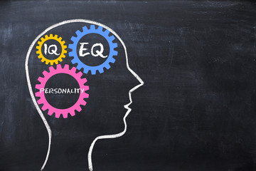
Science & EQ
How can we?
  Deepen and interpret our thoughts and emotions
  Learn where our emotions arise from = Nature
  Understand how our childhoods and historical experiences influence us = Nurture
  Commit to the process of navigating our experiences with increased awareness
Emotional Intelligence

Slide 3
Feelings are a state not an existence
Skills Practice
Learning to track & understand EMOTIONS
Emotional Intelligence
Notes:
We learn from the process of inquiry
Observation
What did you notice? In your mind? Your emotions? Your body?
What happened at points of transition?
Reflection
What does this tell us about how the mind works?

Slide 4
I want you to imagine…
You wake up in the morning and find out it is a snow day!
Your best friend broke their ankle playing hockey.
You just got your license and you wrecked your car on the first day.
Your brother is hiding in your room and jumping out and surprising you.
If you don’t pass your next exam you will not graduate from High School!
Emotional Intelligence
Notes:
Invite tracking of sensation
Observation
What did you notice? In your mind? Your emotions? Your body?
What happened at points of transition?
Reflection
What does this tell us about how the mind and body work together?

Slide 5

3 Parts of your brain
Regions | Nicknames | Function
Reptilian | Downstairs Brain | Survival
Limbic | Mid Brain | Feel
Frontal Cortex | Upstairs Brain | Think/Interpret/Act
Emotional Intelligence
Notes:
While you were tracking sensation, 3 parts of your brain were active.

Slide 6
Reptilian - Downstairs Brain
Constantly responding to threats & safety cues
Communicates through Fight, Flight and Freeze
NOTE: these can be real or perceived
This means feeling comes before thinking! Uh oh!
Chemicals released are strongly tied to +/- motivation
Emotions start here and send info. to the mid-bran
Emotional Intelligence
Notes:
Threat seen as stressful, adrenaline and cortisol
Threat seen as positive dopamine, serotonin and oxytocin

Slide 7
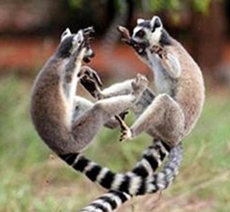
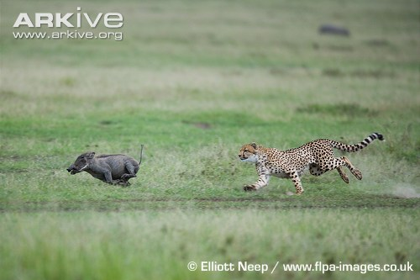
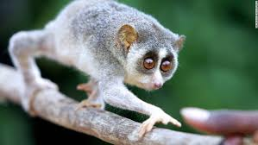



Fight - Flight - Freeze
Emotional Intelligence
Notes:
Fight – “I can”
Flight – “I want to get away”
Freeze – “I can’t”
Antidote x5 senses
Communicates to your limbic brain

Slide 8
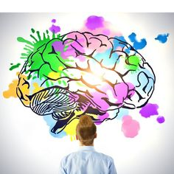
Limbic Brain – Mid Brain
Sends chemical messages throughout the body
Emotions are the affect of those messages
They manifest as feelings and deepened sensations in the body
Emotional Intelligence

Slide 9

Frontal Cortex - Upstairs Brain
Communicates through received data from the other parts of the brain.
Communicates through historical repetitions = nurture
These belief systems drive our behavior = nature & nurture
Behavior and motivation can be positive (+) or negative (-)
Emotional Intelligence
Notes:
Based on our belief systems, the chemicals that are released, etc.

Slide 10
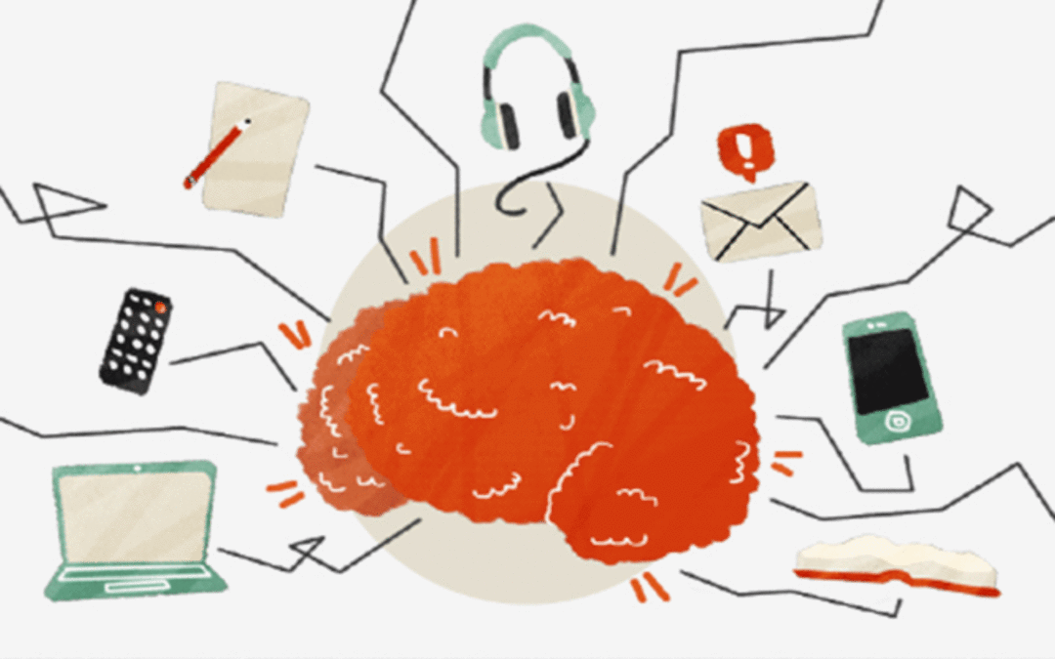
Why does it matter?
As we go through our thoughts, feelings, and actions of the day people reported spending roughly 47% of our time thinking about something other than what they were actually doing.
We spend half our lives distracted from our true experience!
Emotional Intelligence
Notes:
Our amount of distress and medicating are increasingly on the rise!
EQ and Mindfulness are the antidote

Slide 11

REMEMBER
Application
  The quickest way to intensify an emotion is to try not to have it!
  Pay Now, or Pay Later
  If you numb one, you numb them all!
  If you react to them all, you have them all!
Emotional Intelligence
Notes:
White elephant example
Emotions can be very expensive

Slide 12
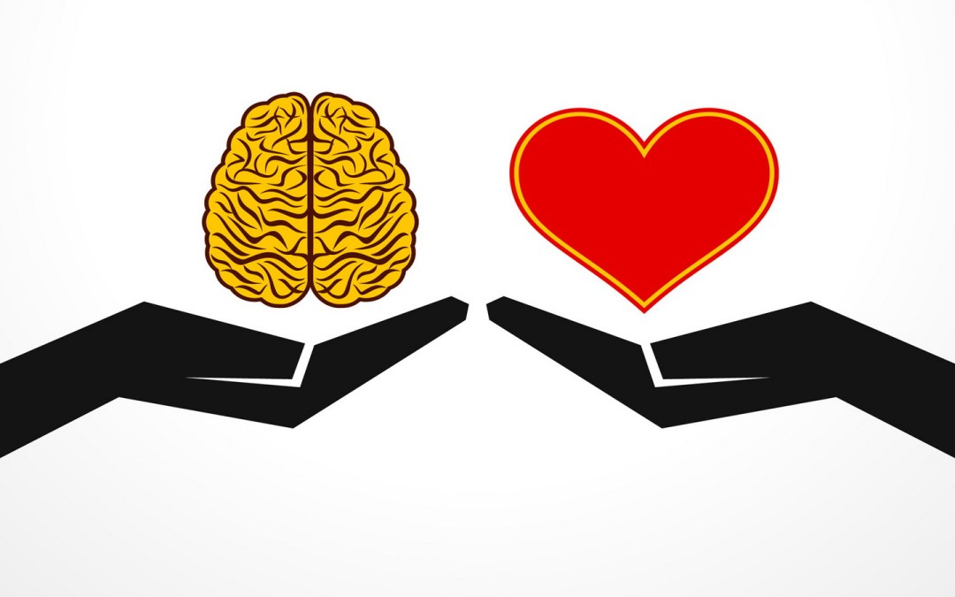
In Closing
“An emotion can last 5 seconds, 5 years or 5 minutes it just depends on when and how you face it.”
Emotional Intelligence

